Slide 1


Automatic License Plate Detection and Recognition
MIS 5600 - DEEP LEARNING AND TEXT ANALYTICS
Project Group: Bipika Sapkota and Vyshali Poola
Presented to: Dr. Vijayan Sugumaran

Slide 2




Introduction
Automatic License Plate Recognition (ALPR) has become an essential component of modern intelligent transportation systems, supporting applications such as traffic law enforcement, automated tolling, smart parking systems, border security, and autonomous vehicle perception. An effective ALPR system relies on two crucial tasks:
Plate Detection
Text Recognition
Accurately identifying the license plate's precise location within an image.
Reliably recognizing the alphanumeric characters on the detected plate.

Slide 3

2 State-of-the-Art Detection Approaches
This project investigates two leading deep learning models for the license plate detection component of the ALPR pipeline:
YOLOv8: Speed & Real-time Inference
A single-stage detector optimized for fast, real-time inference while maintaining strong accuracy.
Faster R-CNN: Precision & Accuracy
A two-stage, region proposal-based detector renowned for its high detection accuracy.

Slide 4

Problem Statement
License Plate Detection
License Plate Text Recognition
Key Questions Explored:
Which detection model (YOLOv8 vs. Faster R-CNN) offers superior accuracy and robustness?
Which OCR method (EasyOCR vs. PaddleOCR) yields better text extraction?
How do preprocessing techniques influence end-to-end ALPR performance?
How do the models compare in terms of accuracy (Precision, recall, F1 score) and processing speed?

Slide 5
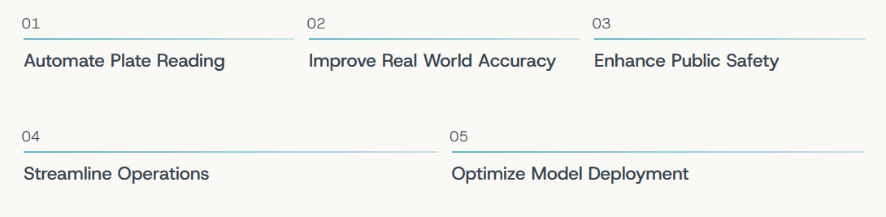
Business Need
As transportation systems evolve, reliable ALPR technology is critical for enhancing safety, efficiency, and operational excellence. Organizations need ALPR to:

Slide 6
Dataset Overview
Our project leveraged a comprehensive vehicle license plate dataset from Roboflow.com, specifically curated for diverse real world scenarios.
8,152
7,337
Total Images
Training Set
815
80:20
Validation Set
Train:Valid Split
Data Preparation:
Images resized to 640x640.
YOLO and COCO Json format export.
Internal normalization & augmentation during training.

Slide 7
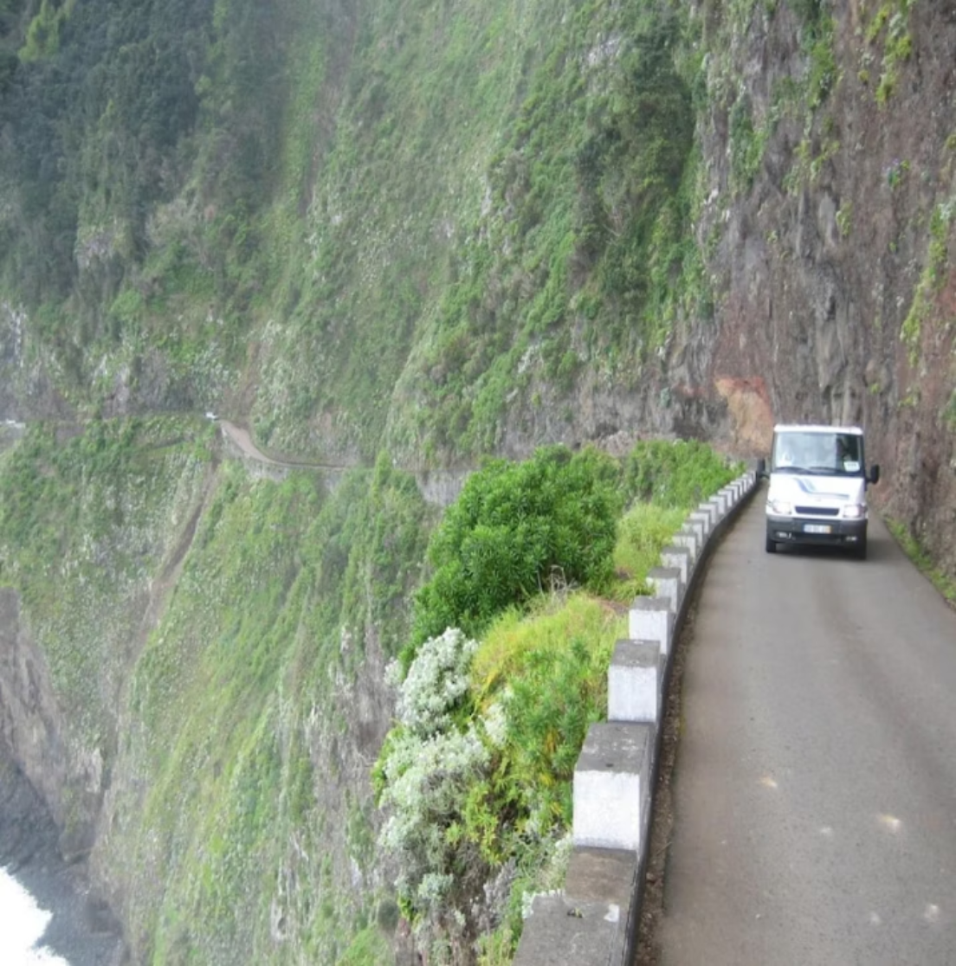
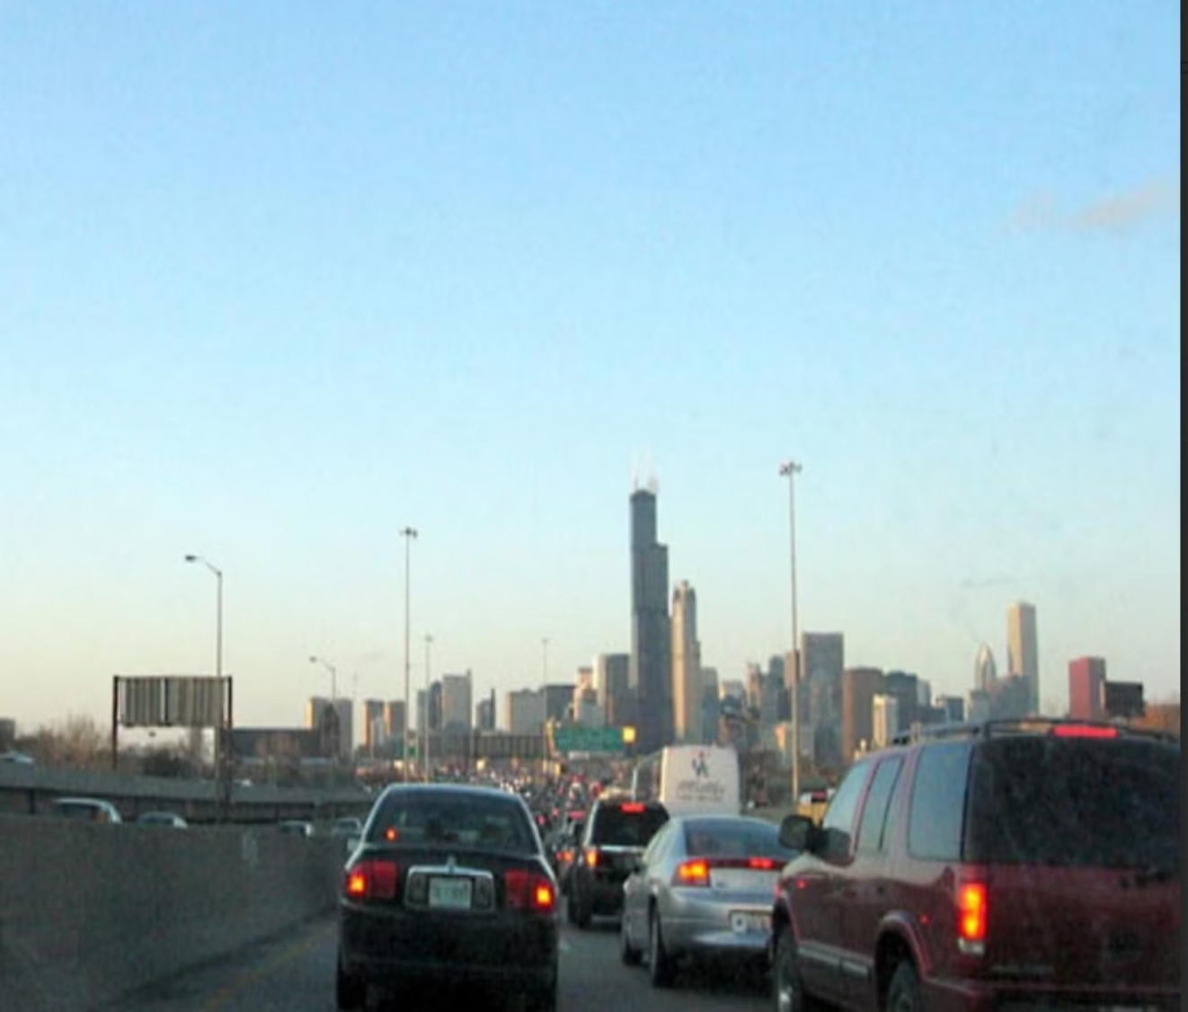
Exploratory Data Analysis
Our EDA process confirmed the dataset's high variability, critical for training robust detection models. Sample images are:
Challenging Lighting & Obstruction
Low Contrast & Small Targets
This visual inspection ensures data quality and variety, verifying that our models are trained on realistic scenarios, encompassing both easy and difficult plate detection cases.

Slide 8

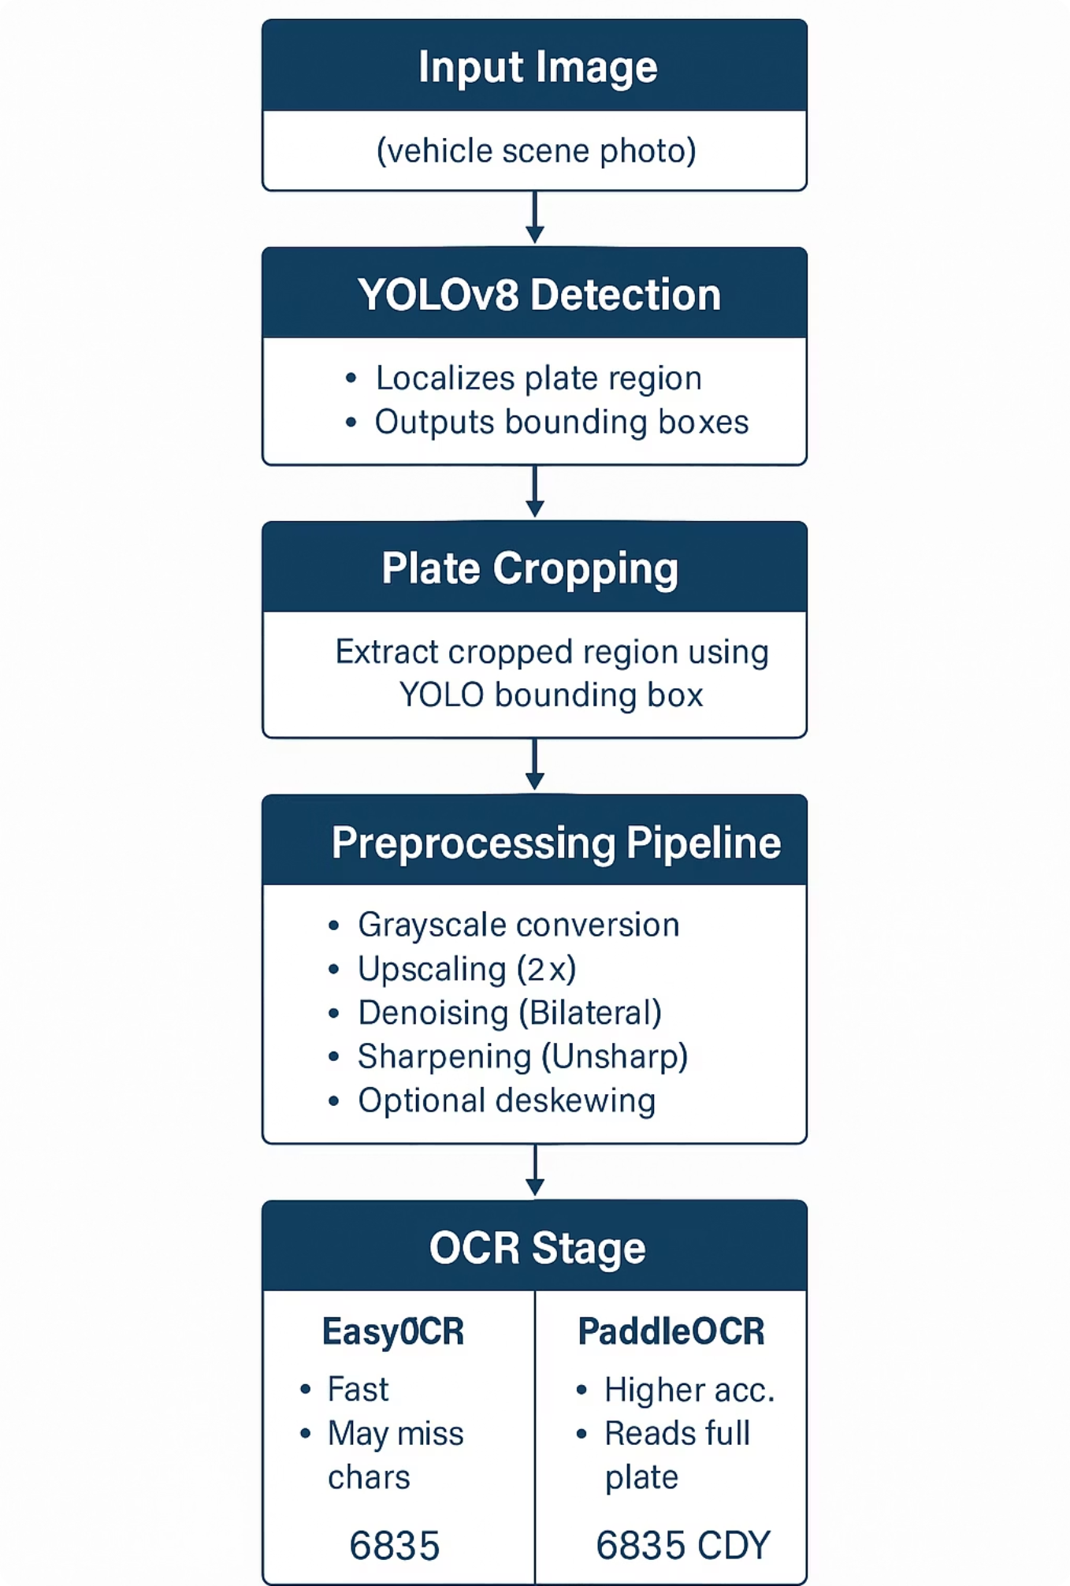
Model Building: YOLO for Speed
# Training code from ultralytics import YOLO model = YOLO("yolov8n.pt") results = model.train( data=DATA_YAML, epochs=20, imgsz=640, batch=16, workers=2, device=0 if torch.cuda.is_available() else 'cpu' )

Slide 9
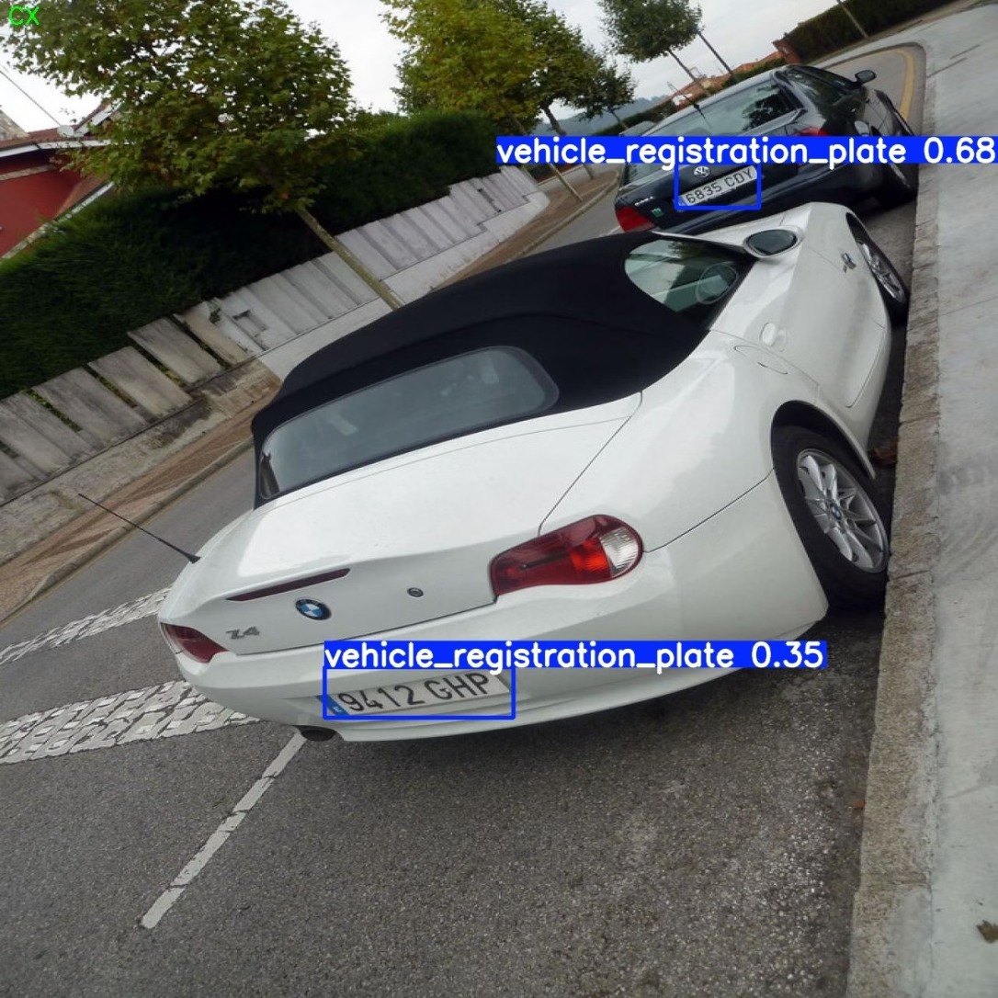
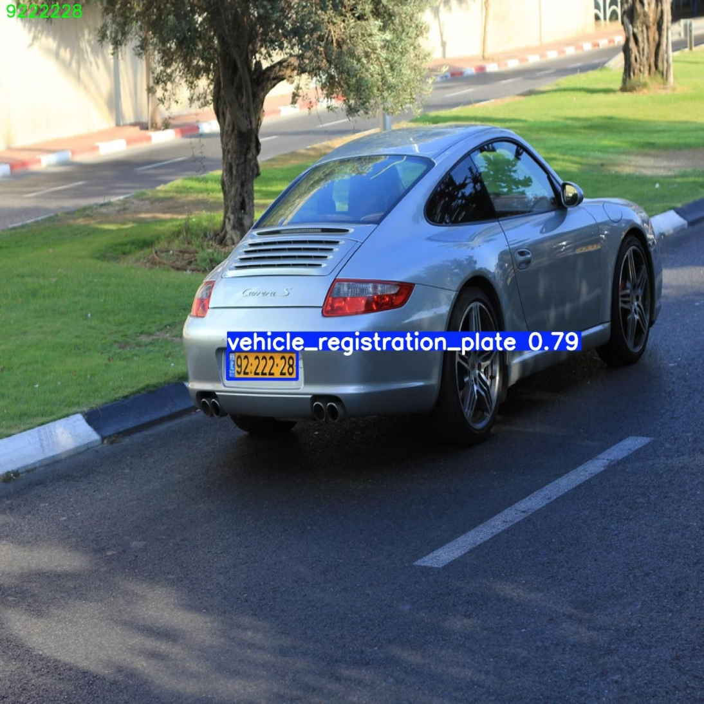
YOLO Model Insight
YOLOv8 model demonstrated successful license plate detection across diverse road scenarios, providing bounding boxes and confidence scores for each identified plate.
Confidence: 0.68
Confidence: 0.79
Detection of a white convertible, showing moderate certainty in plate localization.
Stronger detection certainty indicating robust performance under varying conditions.

Slide 10
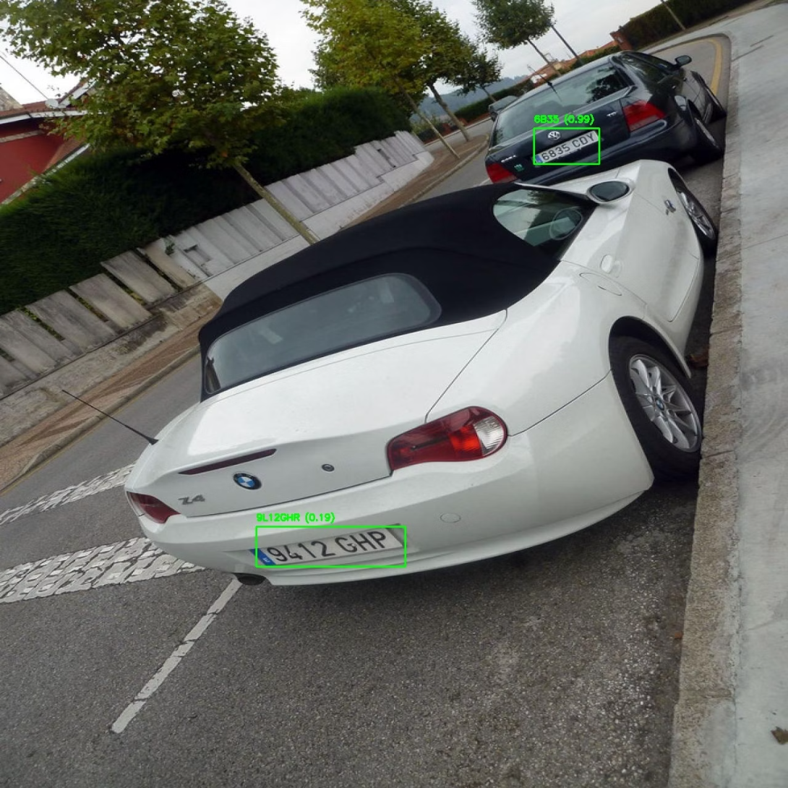

Model Application
Original Plate - "6835 CDY"
EasyOCR
PaddleOCR
EasyOCR output: 6835
PaddleOCR output: 6835 CDY
Issue: It captured only the first four characters instead of the full plate"6835 CDY".
Observation: PaddleOCR is more robust for multi character lines and supports stronger text line detection.

Slide 11
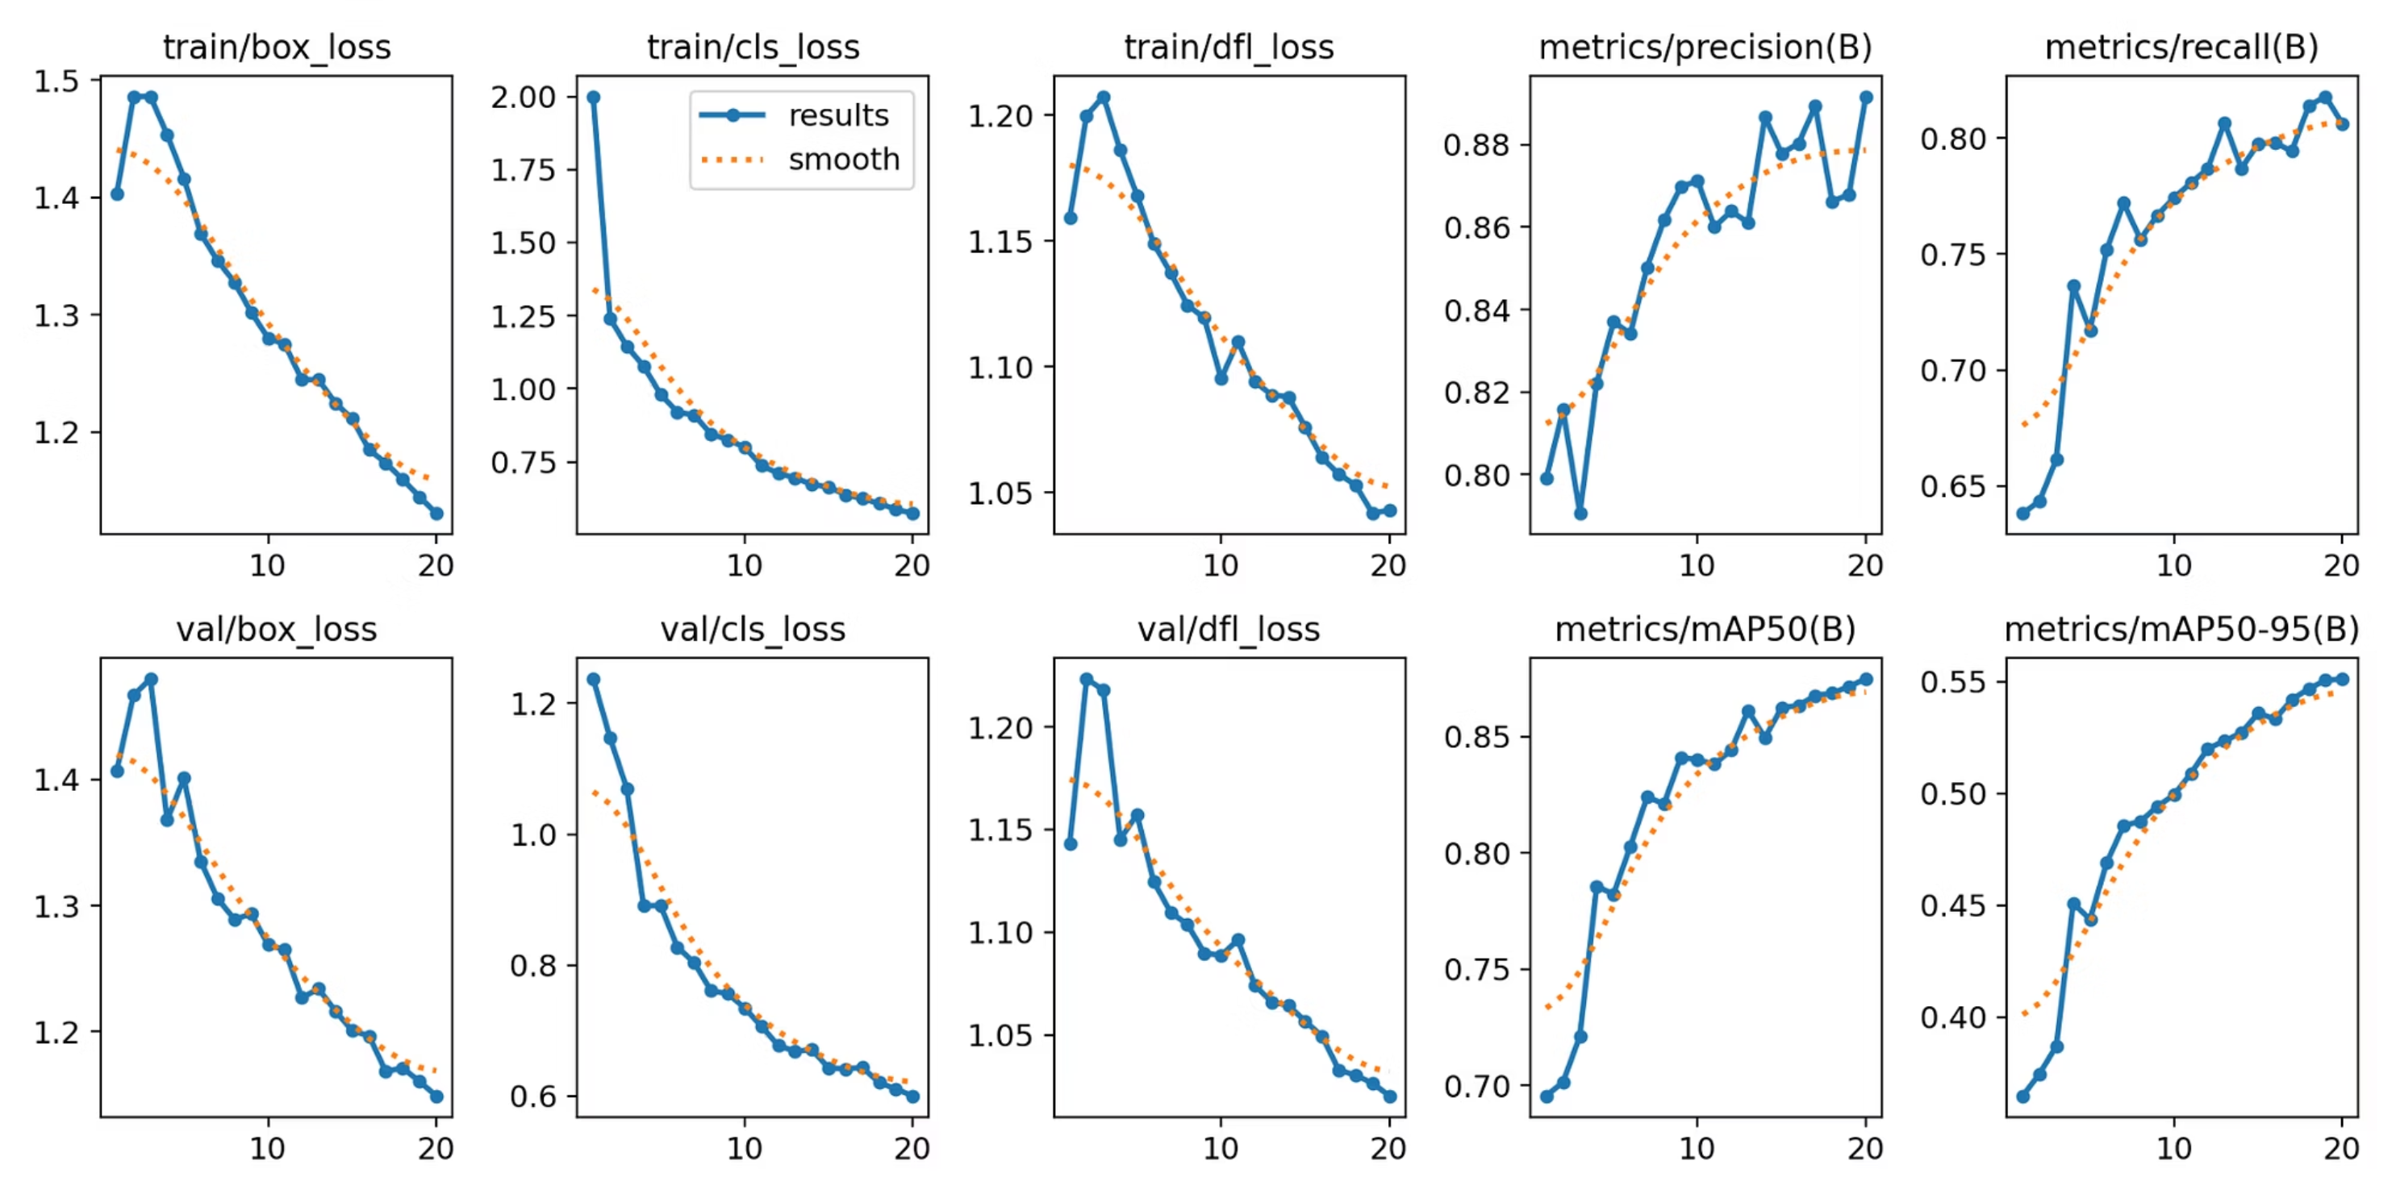
Model Metrics

Slide 12
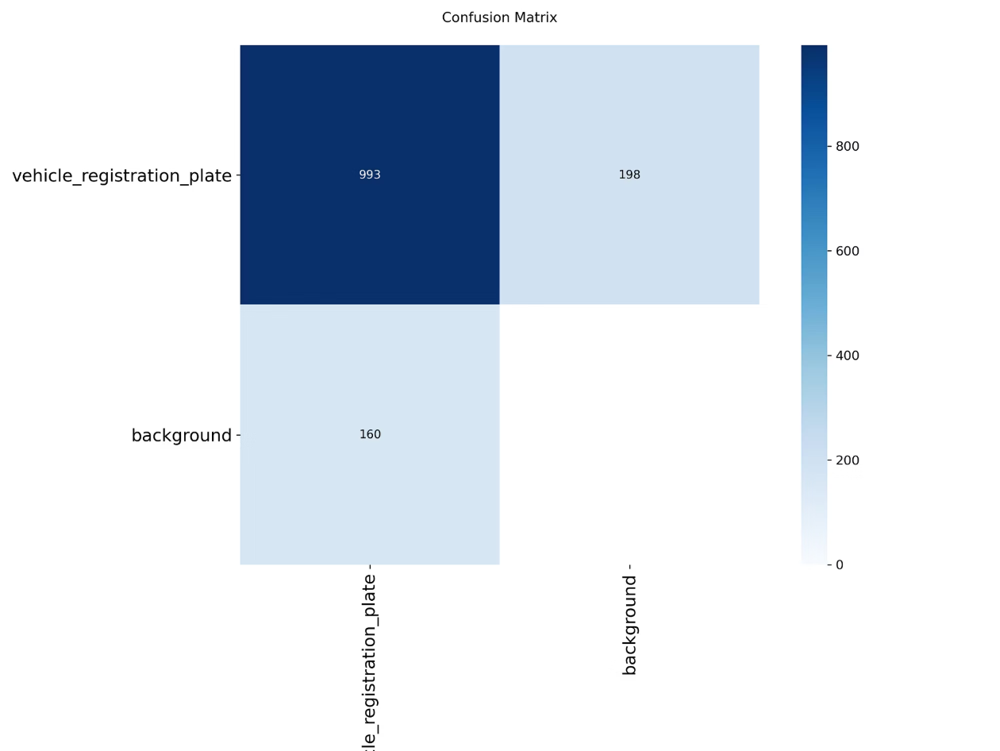
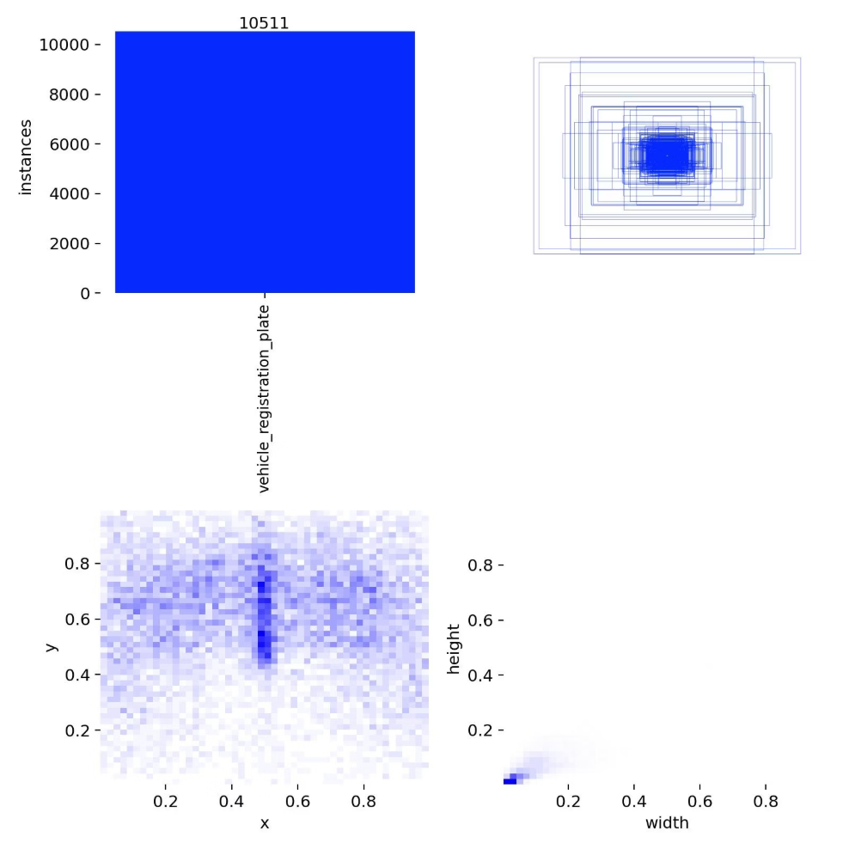
Confusion Matrix and Label Distribution Plot
993 true positives
YOLO correctly detects most license plates.
198 false positives
Model sometimes predicts plates on background areas.
160 false negatives
some plates are missed in challenging conditions.

Slide 13
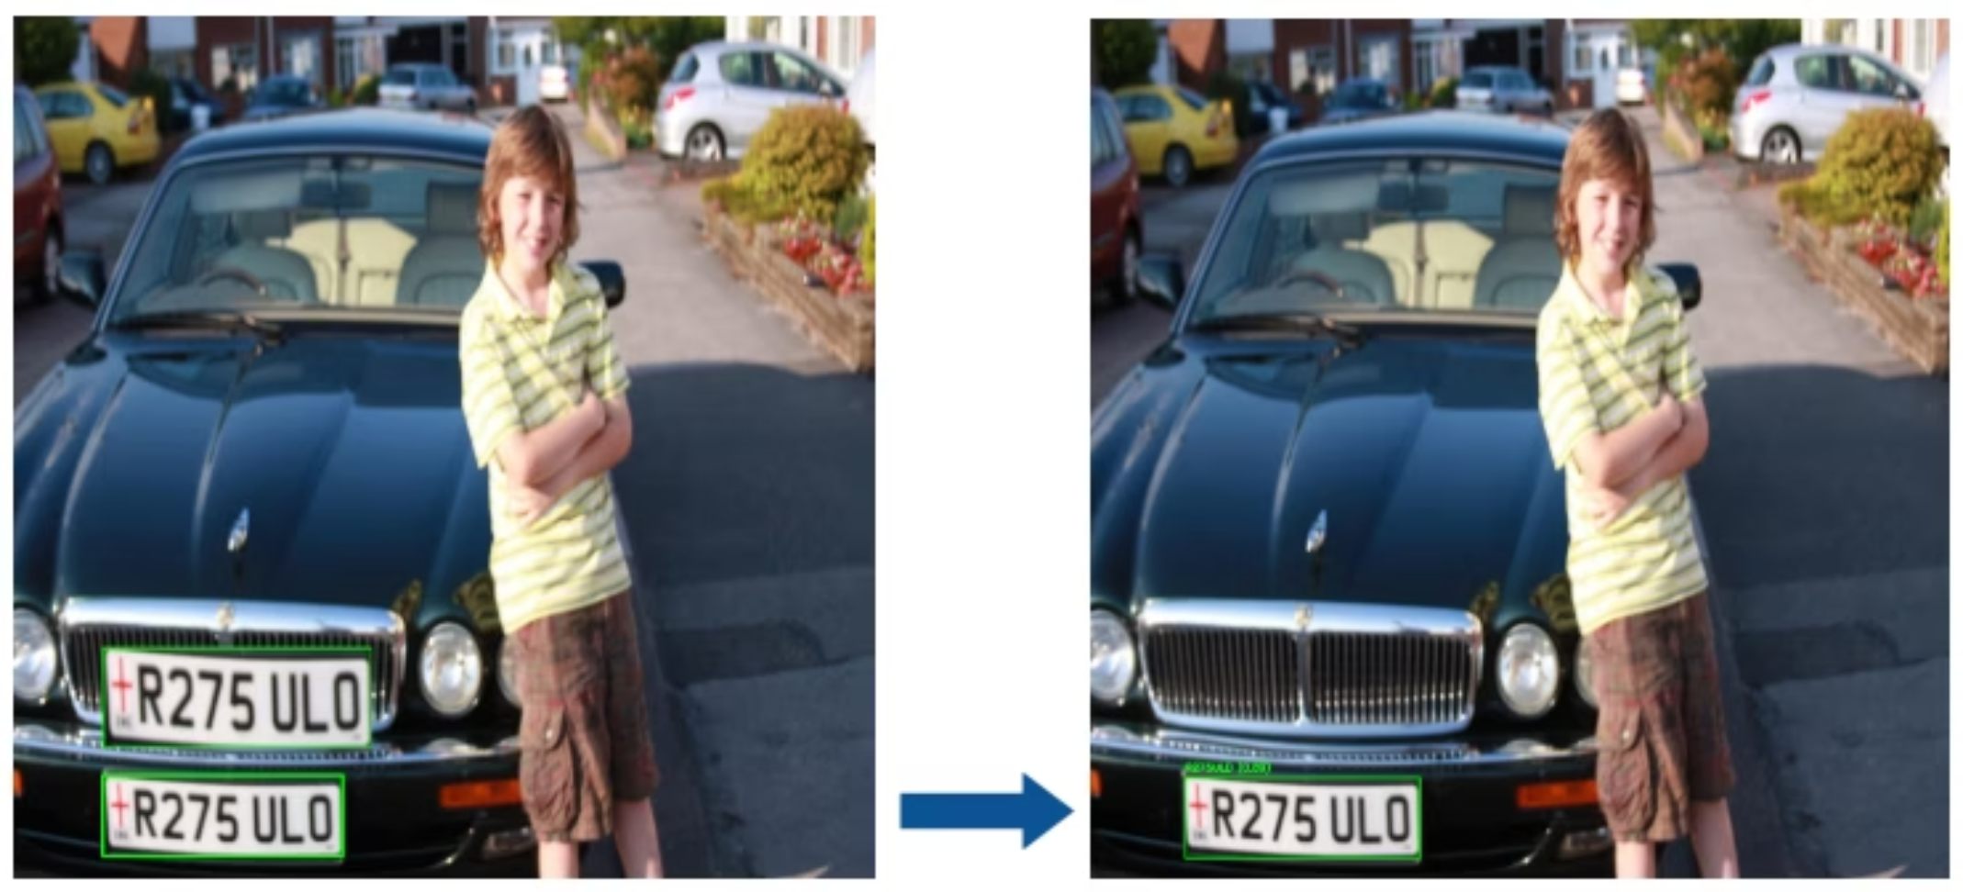
Model Improvements
Preprocessing pipeline added (grayscale, deskewing, contrast boost, super-resolution)
Improved OCR accuracyBy reducing blur/noise and straightening tilted plates.
Overall effect Higher confidence predictions and more reliable recognition in real world conditions

Slide 14
Model Building: Faster R-CNN for Accuracy
For high accuracy, we developed a Faster R-CNN model based on a pre-trained COCO model, customized for license plate detection.
# Faster R-CNN Model model = torchvision.models.detection.fasterrcnn_resnet50_fpn(weights="DEFAULT") num_classes = 2 # background + license plate in_features = model.roi_heads.box_predictor.cls_score.in_features model.roi_heads.box_predictor = FastRCNNPredictor(in_features, num_classes) model.to(device) NUM_EPOCHS = 30 LR = 0.005 MOMENTUM = 0.9 WEIGHT_DECAY = 0.0005

Slide 15
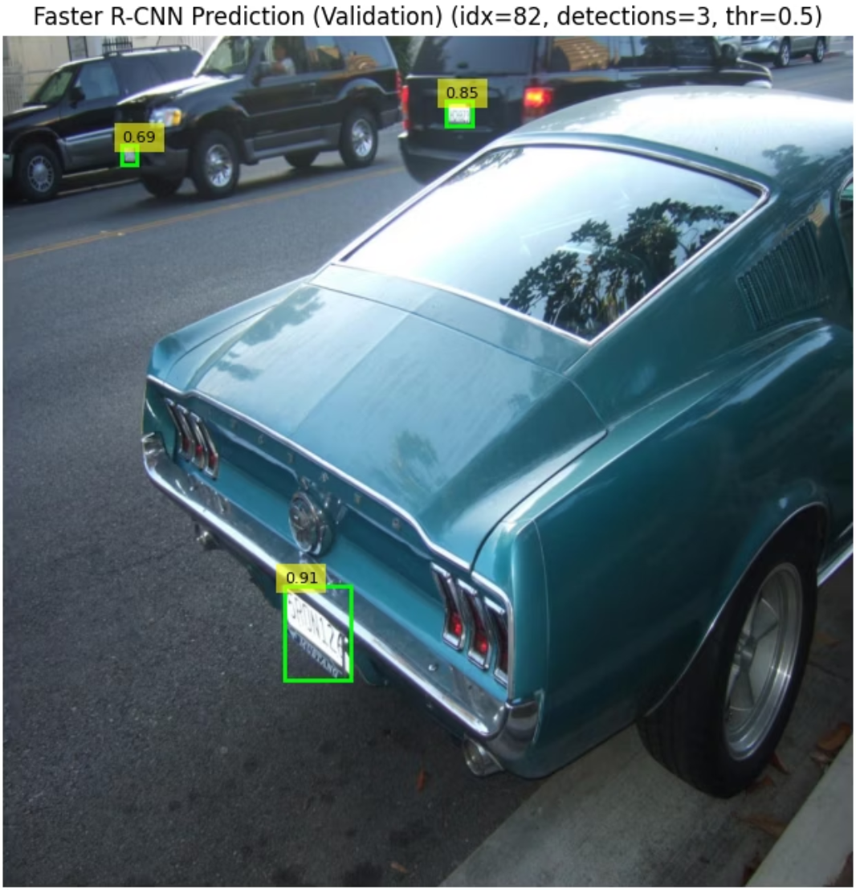
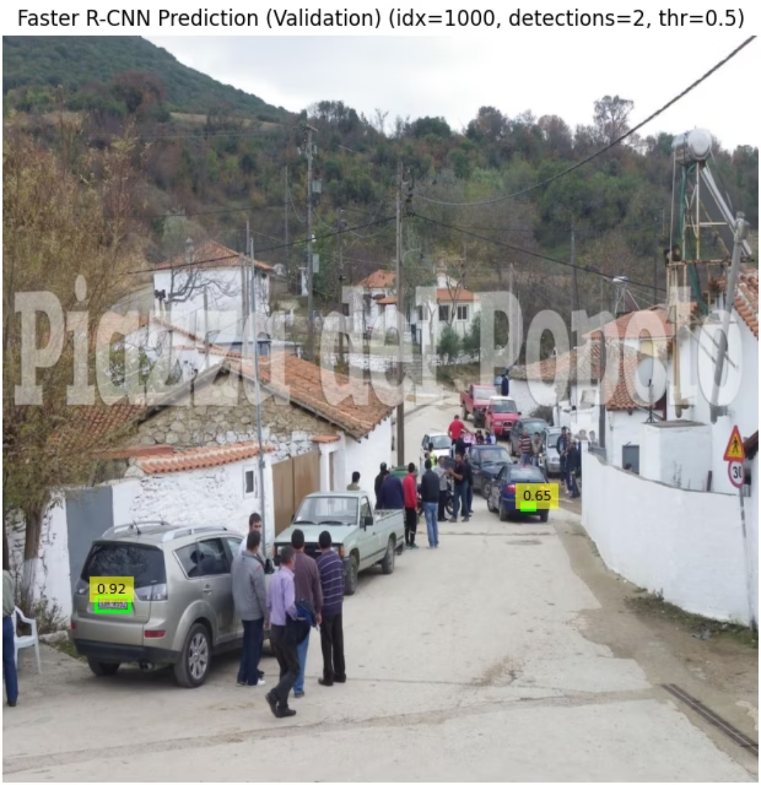
Faster RCNN Model Insight
Faster RCNN model demonstrated successful license plate detection across diverse road scenarios, providing bounding boxes and confidence scores for each identified plate.
Detected plate with high confidence (0.91).
Detected two plates in a crowded street scene.
Identified nearby vehicles' plates with solid scores (0.69, 0.85)..
Strong confidence (0.92) and moderate at far distance (0.65).
Shows the model ability to detect plates accurately even at angles and in scenes with multiple vehicles.

Slide 16
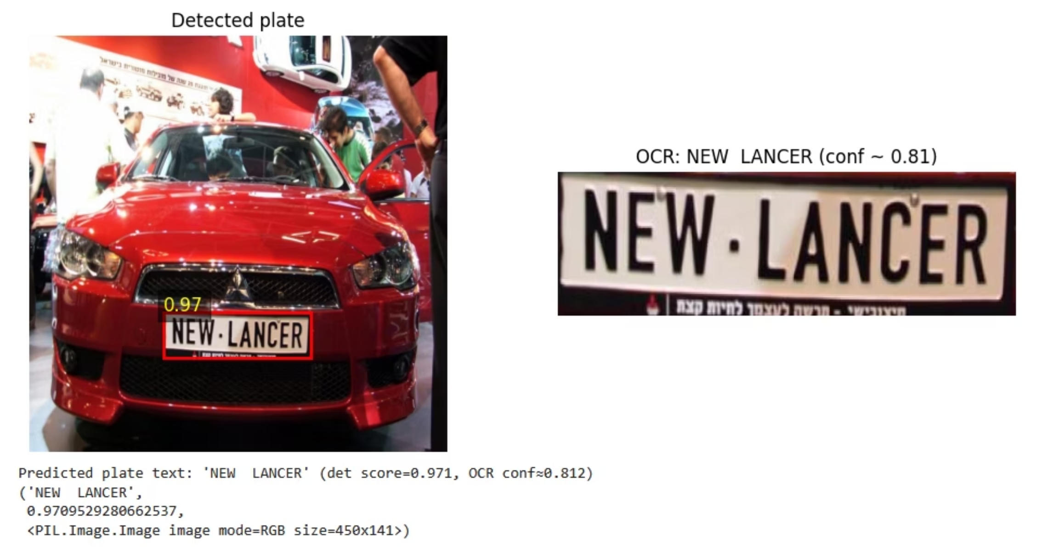
Model Application
Plate “NEW LANCER” detected with high confidence (~0.97).
OCR accurately read the text with strong confidence (~0.81).
Clear, front-facing plate contributed to reliable detection and OCR.

Slide 17
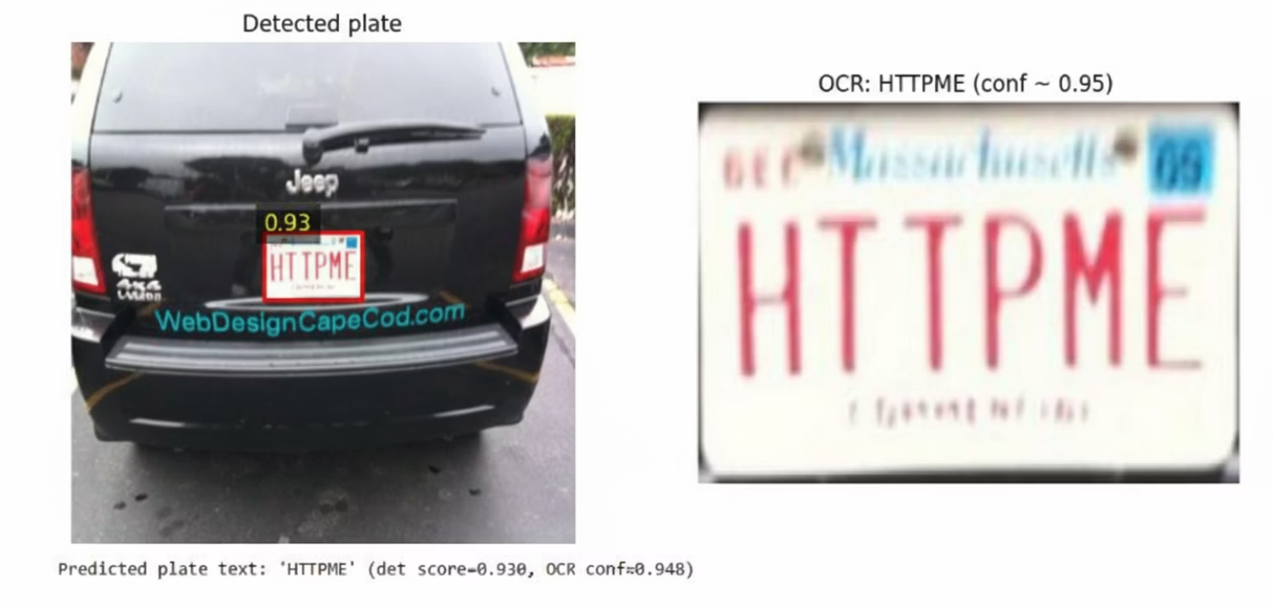
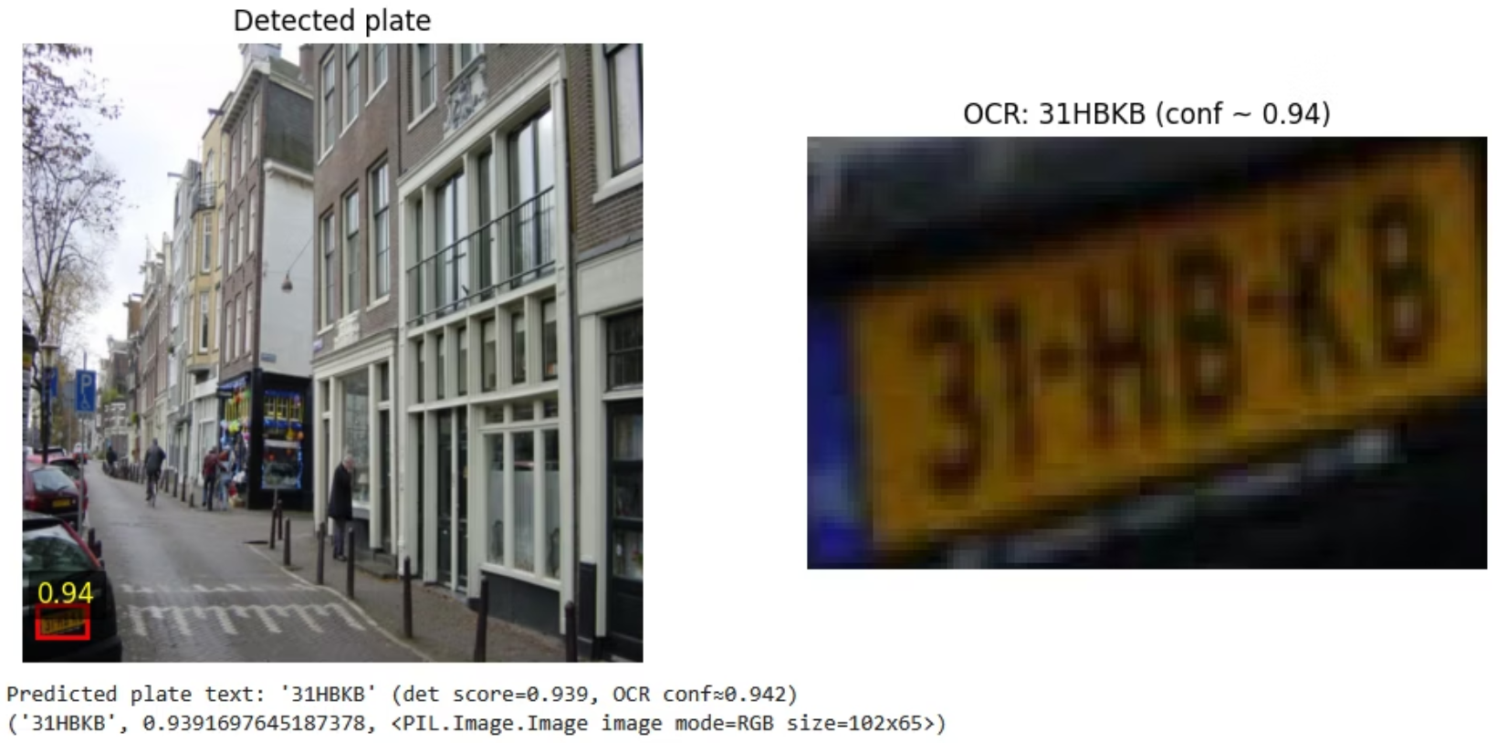
Model Application
Plate detected with high confidence (~0.93)
Plate 31HBKB detected with high confidence (~0.94).
OCR correctly read text: HTTPME (~0.95)
OCR read the text accurately with strong confidence (~0.94).

Slide 18
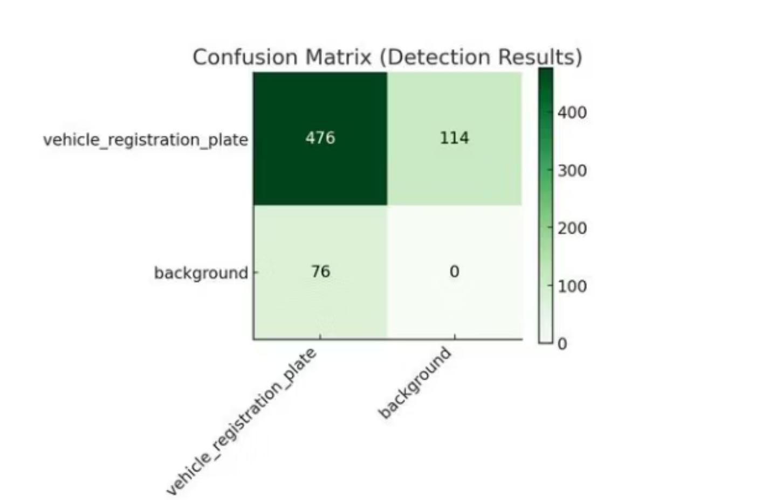
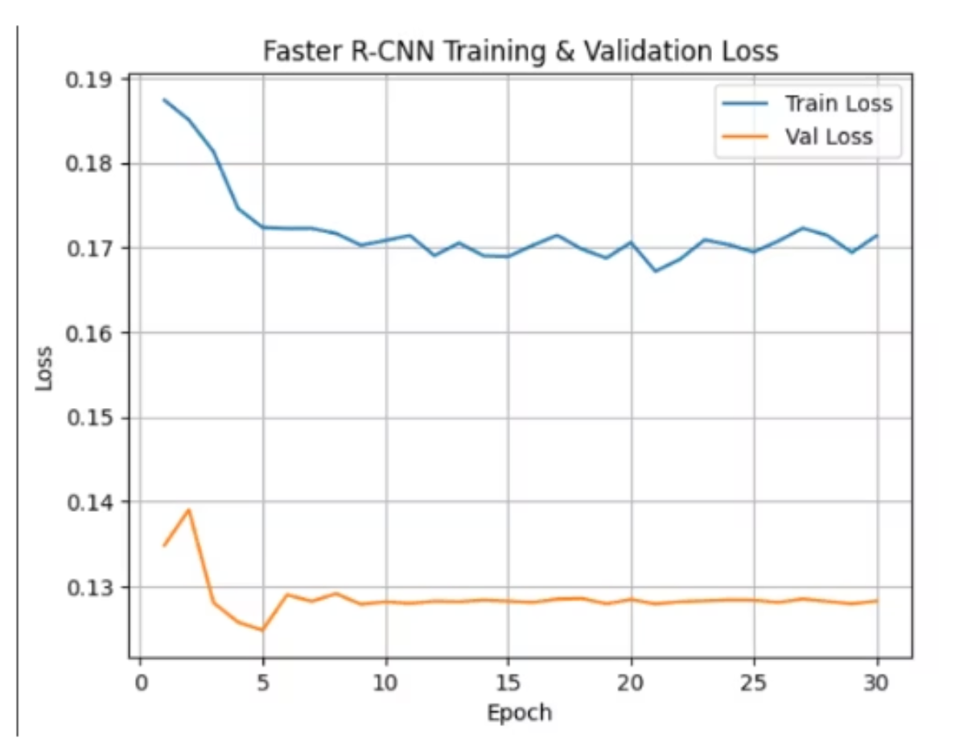
Confusion Matrix and Training & Validation Graph
Model correctly detected 476 plates, with 114 missed and 76 false positives.
Training loss steadily decreased, indicating the model learned effectively.
No background samples were incorrectly classified as plates.
Validation loss remained stable, showing no major overfitting.
Shows strong detection ability but room for improvement in reducing missed plates.
Overall trend suggests good model convergence over 30 epochs

Slide 19
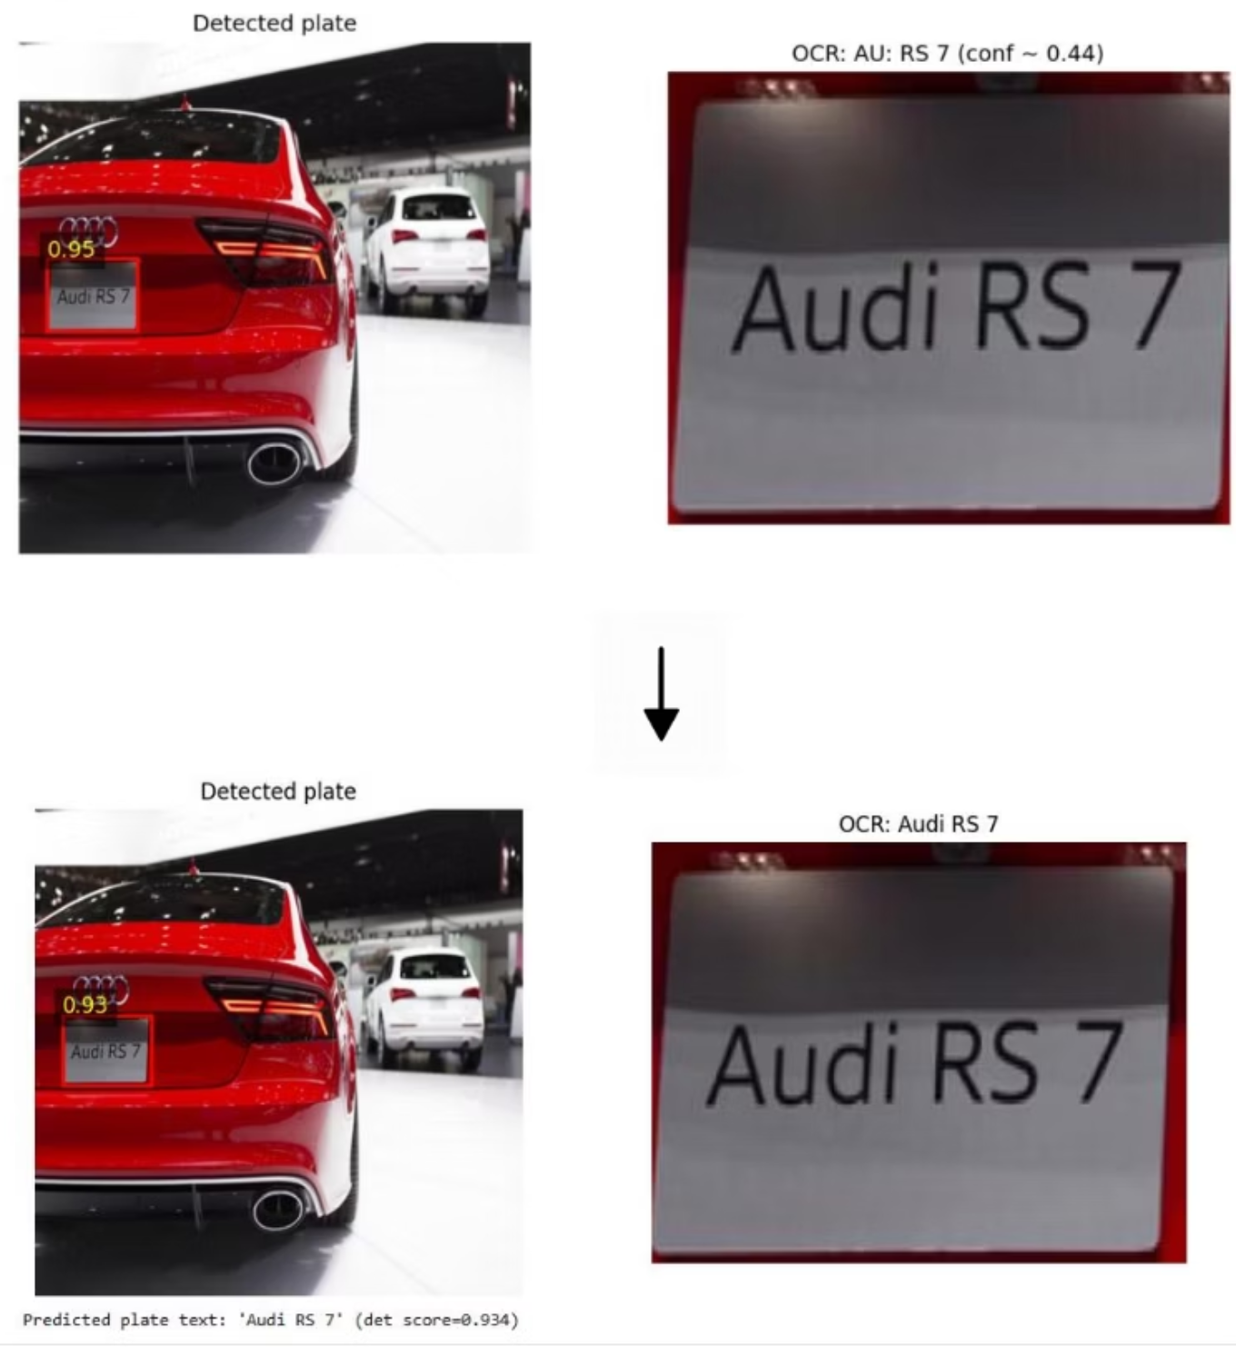
Plate Detection Improvement
Initial detection cropped the plate poorly, and OCR misread it as “AU: RS 7” with low confidence.
Re-ran OCR on the improved crop, allowing it to read the text more clearly and with higher confidence. This refinement corrected the OCR output from “AU: RS 7” to the accurate “Audi RS 7.”
After refining the plate crop, OCR correctly read
“Audi RS 7” with higher confidence.

Slide 20
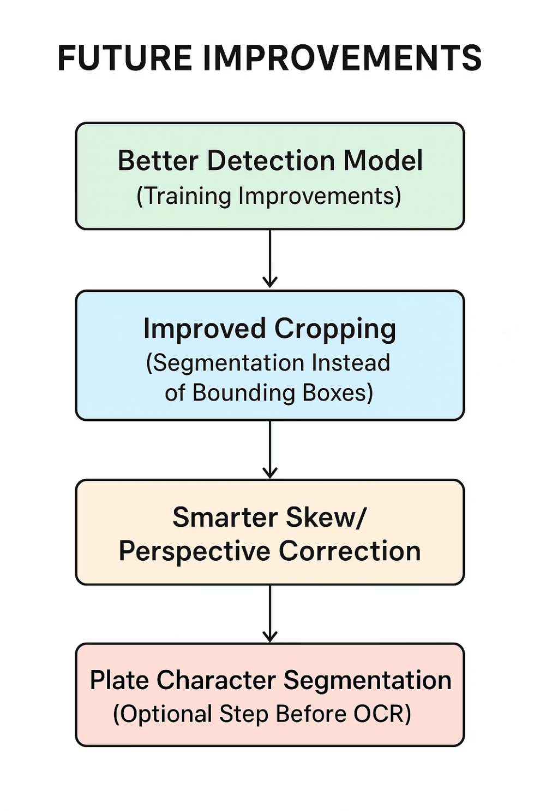
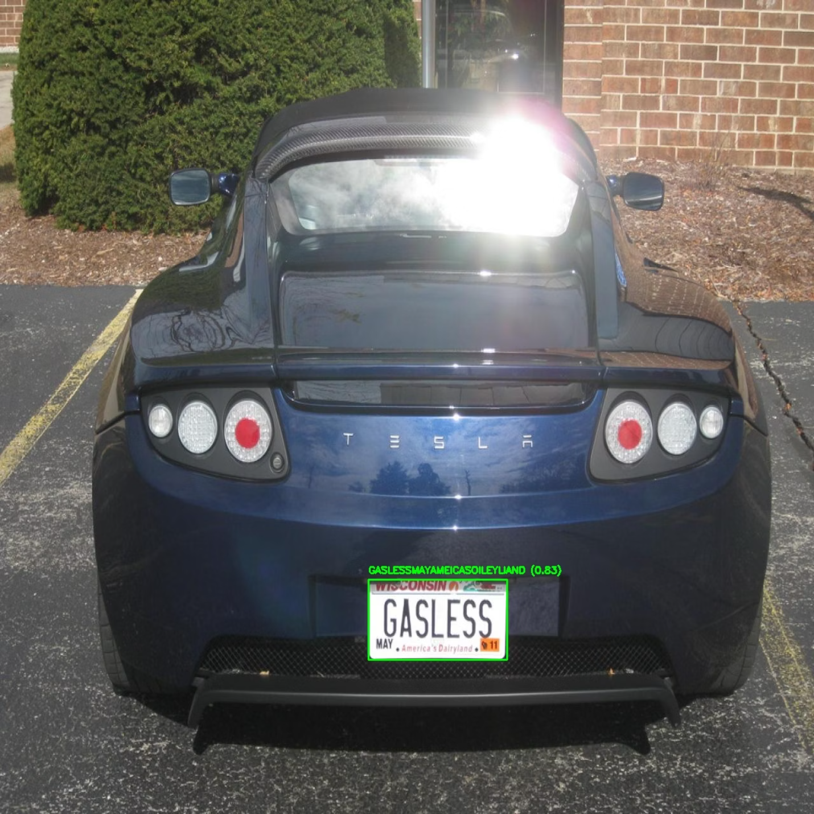
Model Improvements

Slide 21

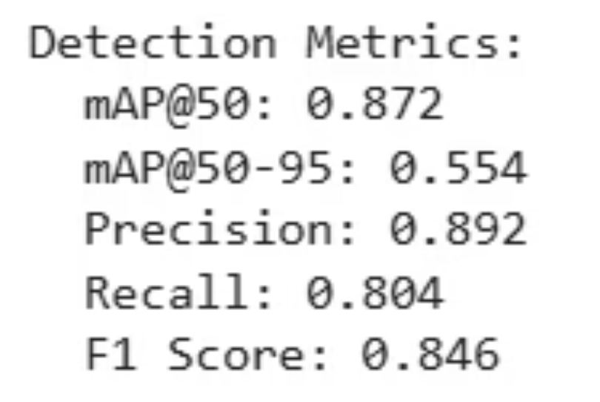
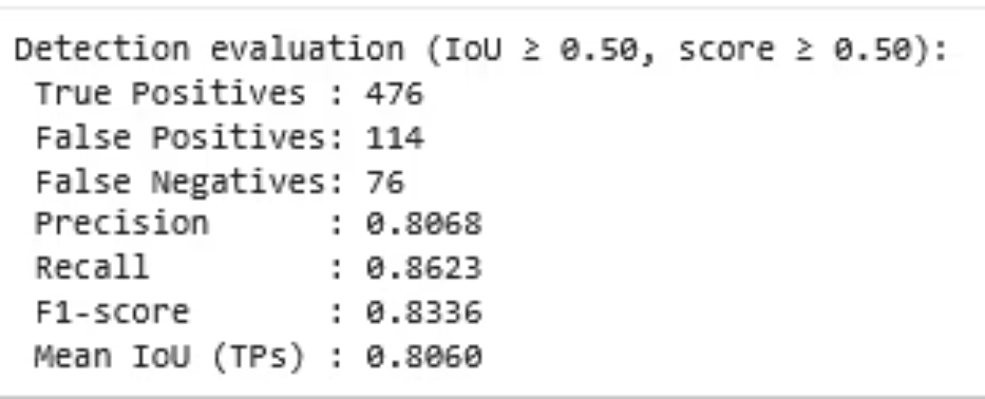
Conclusions
YOLO Model
Faster RCNN
YOLO Model performed better overall.
Higher Precision
Higher F1-Score
Much higher mAP@50
Faster inference → better for deployment

Slide 22

Thank You!

